Slide 1
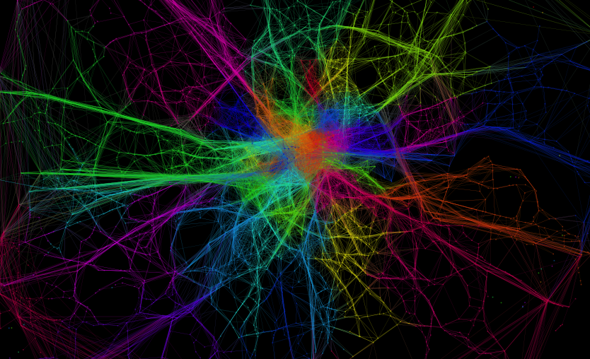
Advanced Clustering
CASA0009: Spatial Data Capture, Storage and Analysis
CASA0006: Data Science for Spatial Systems
Huanfa Chen

Slide 2
CASA0006
1
Introduction to Databases
6
Advanced Regression
2
Introduction to SQL
7
Classification
3
Advanced SQL
8
Dimension Reduction
4
Data Munging
9
Unstructured Data
5
Advanced Clustering
10
Analysis Workflow

Slide 3
CASA0009
1
Introduction to Databases
6
Advanced Regression
2
Introduction to SQL
7
Interactive Viz 1: HTML + CSS
3
Advanced SQL
8
Interactive Viz 2: Javascript
4
Data Munging
9
Server Side Coding: Node.JS
5
Advanced Clustering
10
Real-time data visualisation

Slide 4
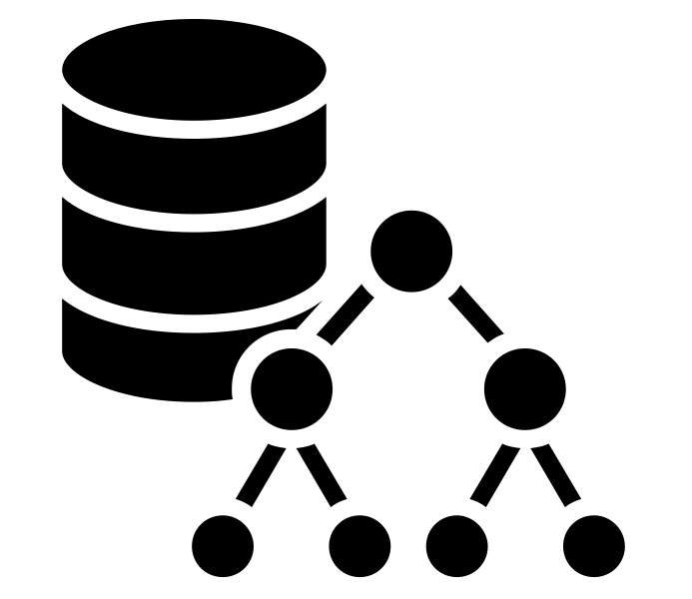
Recap What we already know
Database and SQL
Different data formats
Data cleaning using Python and Pandas
Data Analysis?

Slide 5
Clustering : Plan of Attack
Connecting with CASA0007 (T1)
Standardisation Methods
Z-Score (roughly symmetrical data)
Min-Max rescaling (asymmetric data)
IDR rescaling (data with significant outliers)
Explicit rescaling
Clustering Methods
K-Means
Hierarchical
Clustering Quality
SSE
Silhouette Analysis
Visualisation
Elbow Diagram
Silhouette Plot
Dendrogram
Scatter Plots
Follow Up
Examine cluster centroids
Describe cluster characteristics
Compare against unconsidered variables / categories / geography
Consider analysing clusters separately

Slide 6
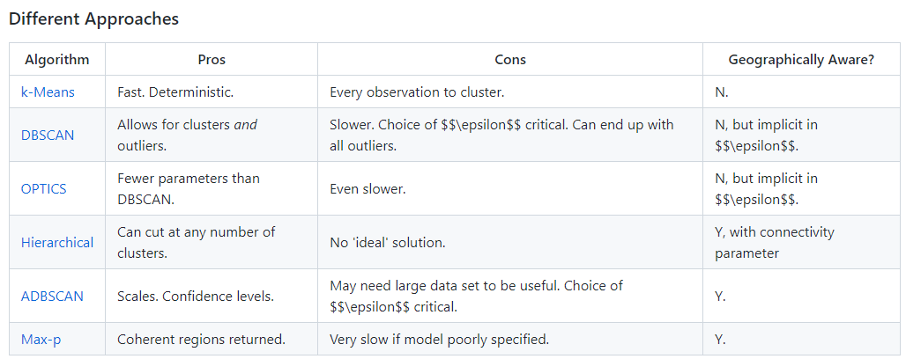
Connecting with CASA0013 (T1, W10)
Geodemographics
Booth map
London Output Area Classification
Clustering methods
https://github.com/jreades/fsds/blob/master/Syllabus.md#week-10-grouping-data

Slide 7
Connecting with CASA0005 (week-)

Slide 8
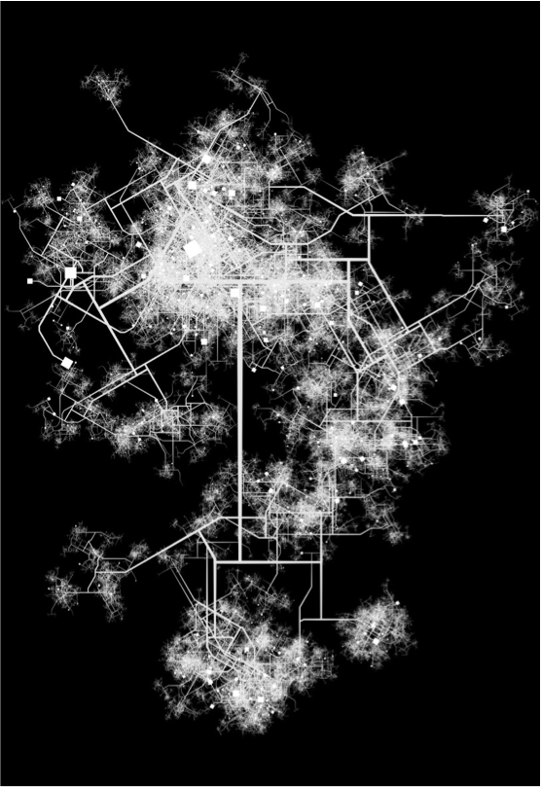
Outline
Definition and workflow
Definition of Clustering
Workflow of Clustering
Standardisation
Clustering Methods
K-Means
Hierarchical
DBSCAN
Others
Choosing clustering methods
Measuring Clustering Quality
SSE/Elbow Method
Silhouette Analysis
Next steps
Visualisation
Observe and interpret

Slide 9
Data Mining Analysis Approach
All data analyses follow a similar methodology, regardless of the dataset and data mining approach being used
Collect Data
2
1
Clean and Prepare Data
Analyse Input Data
3
Select Algorithm
5
6
7
4
Train Algorithm
Calibration Dataset
Test Algorithm
Validation Dataset
Use Algorithm
Interpretation

Slide 10
Data Analysis Common Approaches
Method
Output
Clustering
Creation of Groupings
Regression
Identify Data Relationships
Input Dataset
Classification
Identify Discrete Class
Dimensionality Reduction
Understand Influential Factors
Association Rule Mining
Identify Dependencies
Anomaly Detection
Identify Outliers
Unsupervised: no ground truth
Supervised: with ground truth

Slide 11
Terms in two domains
Term | GIS domain | Data Science domain
point | Spatial point objects with 2-D coordinates (x,y) or (longitude, latitude) | A data record, usually as a vector (x₁, …, x_{n}). Can have any dimension. Also called data point, observation, instance.
space | Geographic space | Data space, consisting of vectors and distance metric. For example, (x₁, …, x₄) and Euclidean distance
Unless specified, we use these terms in the data science domain.

Slide 12
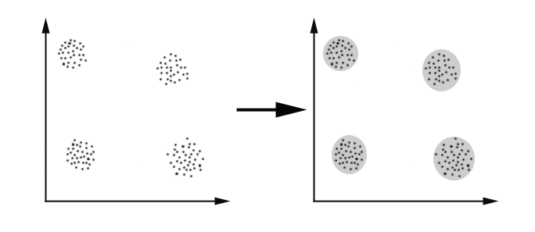
Clustering
Definition
Type of analysis that divides data points into groups based on some similarity criteria

Slide 13
Clustering
Purpose of clustering
Discover groups of similar data points
Extract ‘knowledge’ from data
What is a cluster?
A group of similar data points
The workflow of clustering
Data standardisation
Choosing clustering algorithm
Searching parameters
Interpreting the result

Slide 14
Why standardisation before clustering?
Standardisation makes different dimensions comparable:
You don't want scale in any one dimension to matter more than scale in another.
You don't want differences between values in one dimension to matter more than differences in another.
You don't want skew in one dimension to matter more than skew in another.

Slide 15
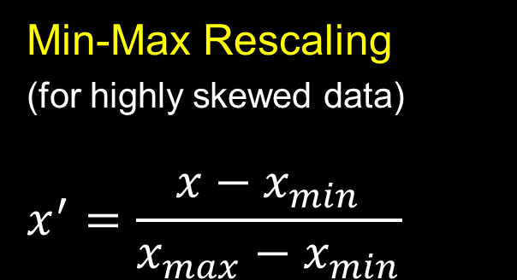


Standardisation
Z score
(for not highly skewed data)
$$z=\frac{x−μ}{σ}$$
Min-Max Rescaling
(for highly skewed data)
$$x^{′}=\frac{x−x_{min}}{x_{max}−x_{min}}$$
IDR Standardisation
(Non-normal data with significant outliers)
$$x^{IDR}=\left\{\begin{aligned}\frac{x−P_{50}}{P_{90}−P_{50}}, x≥P_{50} \\ \frac{x−P_{50}}{P_{50}−P_{10}},x<P_{50}\end{aligned}\right.$$
Criteria
Highly skewed distribution？
Significant outliers?
( See: https://www.ons.gov.uk/methodology/geography/geographicalproducts/areaclassifications/2011areaclassifications/methodologyandvariables )

Slide 16
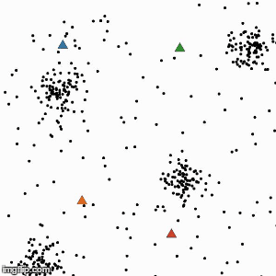
Clustering K-Means Clustering
K-Means clustering breaks down a dataset into groups, based on proximity of points within a multidimensional space.
Iterative Algorithm (Expectation-Maximisation)
Place k centroids randomly within space
Assign points to nearest centroid
Recalculate centroids as the new mean of the cluster
Continue until centroid assignments no longer change
Interactive demo of kmeans:
http://alekseynp.com/viz/k-means.html
Notes:
The first method is k-means. It breaks down a dataset into groups, based on proximity of points. The user should specify the number of clusters for this method, and the algorithm is an iterative process. First, k centroids are randomly placed. And then we assign the points to nearest centroid. And we recalculate centroids as the new mean of each cluster. Then this process continues until the centroid assignments no longer change.

Slide 17
Clustering Problems with K-Means Clustering
Choose k wisely
Requires knowledge of the number of clusters, which you may not know in advance (solution: Elbow method);
Sensitive to initialisation, which can lead to poor solutions (solution: try different random initialisation and pick up the best one);
Sensitive to outliers, which can result in inaccurate clusters (solution: use another clustering method, or remove outliers);
Incapable of handling clusters of a non-convex shape (no solution);
Inapplicable to categorical data (solution: k-modes or k-prototypes).
Non-convex shape
Notes:
Well, this is method is intuitive to understand and use, but it has some problems. It requires to give the number of clusters, and sometimes it is difficult to tell. Also, this method creates clusters regardless of the data distribution, so it is bad for unclustered data. In addition, it is bad for spherically distributed data, and it draws a line across the middle. It is also not good for unevenly sized clusters. In this example, we can see that there are three cluster: bottom, topright, topleft. But in k-means, the topright cluster is divided, and the centroid of the topleft cluster is drawn towards the topright cluster. Lastly, there is no room for nuance in the cluster boundaries or cross-boundary relationships.

Slide 18
Extension of kmeans K-modes and K-prototypes
method | Input variables
K-means | numerical
K-modes | categorical
K-prototypes | numerical and categorical
https://pypi.org/project/kmodes/
Notes:
Well, this is method is intuitive to understand and use, but it has some problems. It requires to give the number of clusters, and sometimes it is difficult to tell. Also, this method creates clusters regardless of the data distribution, so it is bad for unclustered data. In addition, it is bad for spherically distributed data, and it draws a line across the middle. It is also not good for unevenly sized clusters. In this example, we can see that there are three cluster: bottom, topright, topleft. But in k-means, the topright cluster is divided, and the centroid of the topleft cluster is drawn towards the topright cluster. Lastly, there is no room for nuance in the cluster boundaries or cross-boundary relationships.

Slide 19
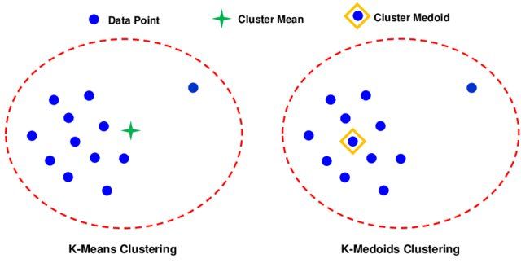
Extension of kmeans K-medoids
 | Cluster ‘centre’ | Distance metric | Robustness to outlier | Computation cost
K-means | Mean of points in a cluster | Distance to the cluster mean | Not robust | Usually low
K-medoids | One of the points in a cluster | Any similarity measure | Robust | Much higher
https://scikit-learn-extra.readthedocs.io/en/stable/modules/cluster.html#k-medoids
https://www.researchgate.net/publication/342871651_An_innovative_hybrid_strategy_for_structural_health_monitoring_by_modal_flexibility_and_clustering_methods/figures?lo=1
Notes:
Well, this is method is intuitive to understand and use, but it has some problems. It requires to give the number of clusters, and sometimes it is difficult to tell. Also, this method creates clusters regardless of the data distribution, so it is bad for unclustered data. In addition, it is bad for spherically distributed data, and it draws a line across the middle. It is also not good for unevenly sized clusters. In this example, we can see that there are three cluster: bottom, topright, topleft. But in k-means, the topright cluster is divided, and the centroid of the topleft cluster is drawn towards the topright cluster. Lastly, there is no room for nuance in the cluster boundaries or cross-boundary relationships.

Slide 20
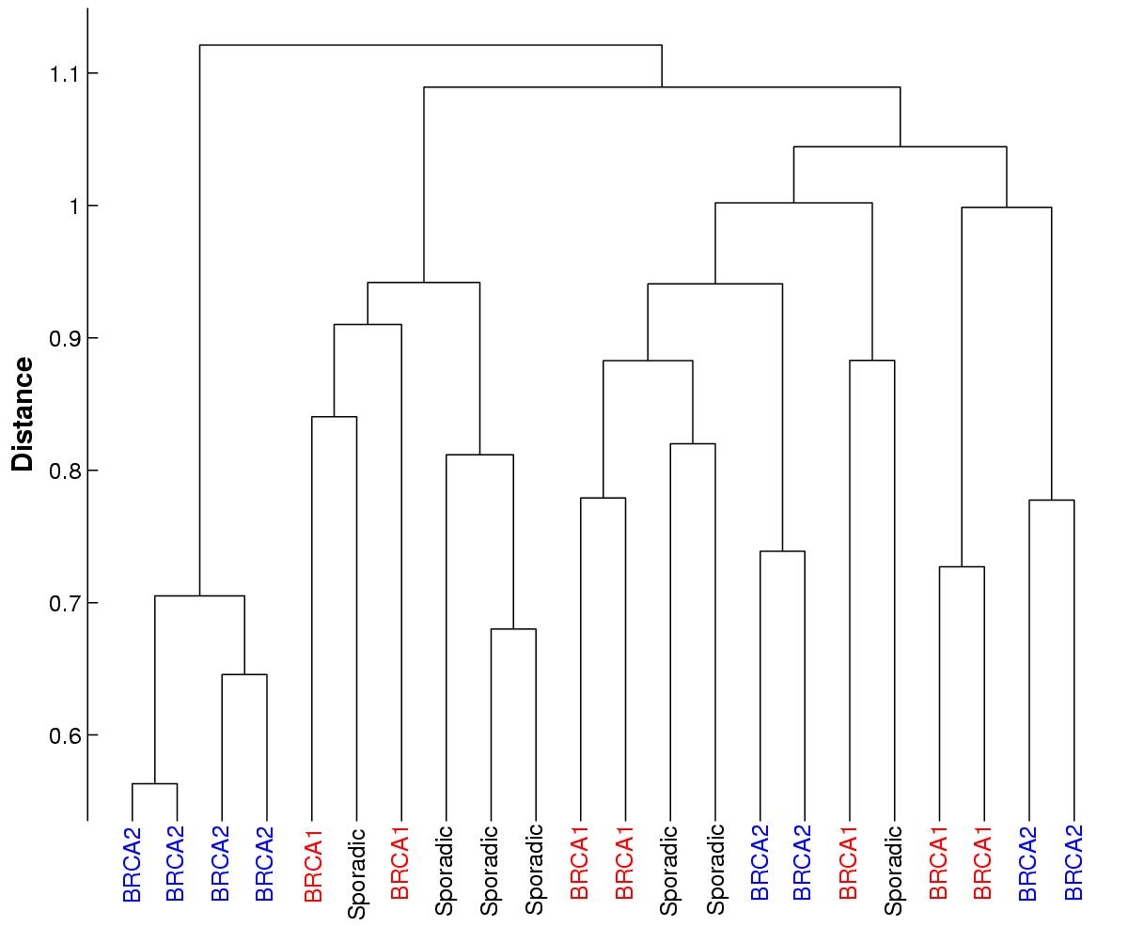
Hierarchical Clustering Agglomerative
Hierarchical clustering builds up clusters based on proximity of instances, ending on reaching predefined number of points
Iterative Algorithm
Start with every point in its own cluster
Merge points according to a linkage criterion (or distance)
Compute centroid of new clusters
Expand linkage threshold and continue until all points in one cluster
Pros
Users can choose the level in a hierarchy structure;
No prior knowledge of data required
Notes:
The second method is called hierarchical clustering. It start with every point in its own cluster, and merge points according to a linkage criterion or a distance measure. Then, the centroid of new clusters are computed. After that, it expands linkage threshold and continue until all points in one cluster.
In this method, you donot need to specify the number of the clusters, and you can see the clustering process clearly in this dendrogram. You can choose some point to end the clustering, based on your knowledge of data or preference.

Slide 21
Hierarchical Clustering
Dendrogram
A
F
E
D
C
B
D
B
F
C
E
A
r

Slide 22
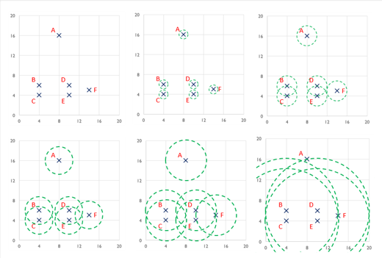
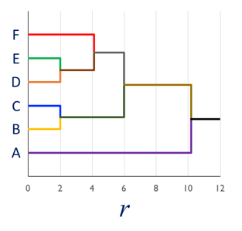
Hierarchical Clustering
Dendrogram

Slide 23
Hierarchical Clustering
Dendrogram

Slide 24
Hierarchical Clustering
Agglomerative Bottom Up: Begins with one cluster per data point; Gradually merge into larger clusters.
Divisive Top Down: Begins with one big cluster; Gradually split into smaller clusters.

Slide 25
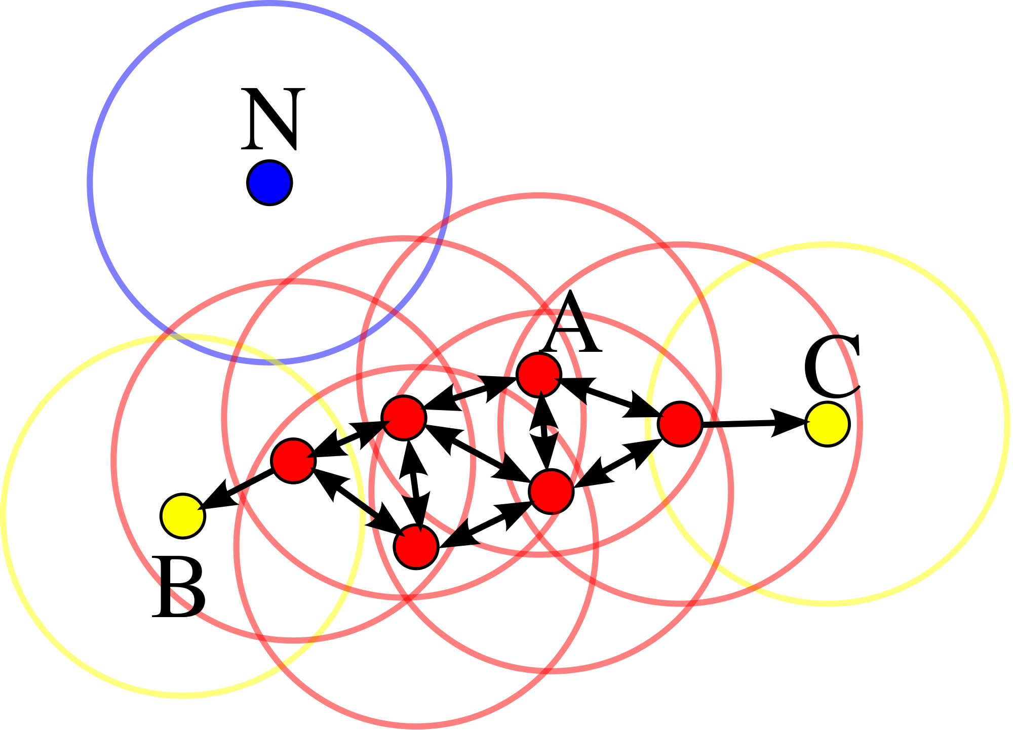
Clustering Density-based – DBSCAN Clustering
DBSCAN builds clusters of points based on local proximity, considering neighbours within a maximum distance threshold
Given ε (search radius) and minPts, points are classified into three classes:
Point p is core point: if at least minPts points are within distance ε of it (including p)
Point p is edge point: if p is not a core point but it is reachable from a core point
Point p is outlier: all points not reachable from any core points
minPts = 3
Notes:
The third method is DBSCAN clustering. It identifies clusters of points based on local density, only within a specified maximum distance. Two parameters are needed: minPts and epsilon.
The idea is: if a point is in the middle of a cluster, then there are at least a number of other points within epsilon distance.
One advantage of DBSCAN is that there is no need to specify number of clusters. But, it does not deal well with uniform data points, where the density difference is not obvious. And, to specify the minPts and epsilon, it requires some knowledge of data.

Slide 26
Clustering Density-based – DBSCAN Clustering
Step 1
Step 2
Step 3
minPts = 3
Connected component of core points
Cluster
Process (given ε and minPts)
Identify core points (with at least minPts neighbours)
Connect core points while ignoring non-core points (forming connected components)
Assign each non-core point to a nearby cluster if it is within ε of a cluster, otherwise assign it to noise
Notes:
The third method is DBSCAN clustering. It identifies clusters of points based on local density, only within a specified maximum distance. Two parameters are needed: minPts and epsilon.
The idea is: if a point is in the middle of a cluster, then there are at least a number of other points within epsilon distance.
One advantage of DBSCAN is that there is no need to specify number of clusters. But, it does not deal well with uniform data points, where the density difference is not obvious. And, to specify the minPts and epsilon, it requires some knowledge of data.

Slide 27
Summary Three clustering methods
method | required parameters | Extensions
kmeans | k (number of clusters) | kmodes, kmedoids
hierarchical | No required parameter before clustering, but you should decide number of clusters afterwards | NA
DBSCAN | ε and minPts | NA
Notes:
The third method is DBSCAN clustering. It identifies clusters of points based on local density, only within a specified maximum distance. Two parameters are needed: minPts and epsilon.
The idea is: if a point is in the middle of a cluster, then there are at least a number of other points within epsilon distance.
One advantage of DBSCAN is that there is no need to specify number of clusters. But, it does not deal well with uniform data points, where the density difference is not obvious. And, to specify the minPts and epsilon, it requires some knowledge of data.

Slide 28
Choosing a cluster method …
There is no best way. Some issues are important:
Ability to cluster at speed for the given data size (the larger data, the fewer choices)
Accommodating the data types (numerical, categorical, or mixed)
Ability to cope with outliers (if the data have many outliers, then choose a method with robustness to outliers)
You can compare different methods and choose the best one

Slide 29
Spatial clustering
The methods above are ‘general-purpose’ clustering.
They are applicable to non-spatial variables (e.g. house price, # bedrooms), or spatial variables (e.g. long-lat).
Note the different implications
If you use non-spatial variables for clustering, a cluster represents a type of ‘observation’ with similar attributes (‘feature homogeneity’)
If you explicitly consider spatial variables in clustering, a cluster represents a geographical ‘place’ or a region (‘geographic cohesion’)

Slide 30
Spatial clustering
Given data points with both non-spatial and spatial variables, there are three approaches to cluster these points:
Clustering on only non-spatial variables, and then exploring the geography of clusters;
Clustering on non-spatial variables while adding constraints of ‘geographic cohesion’;
Clustering on both non-spatial and spatial variables* [beyond range of this lecture]
Note the tension and trade-off between them.
* See this paper: https://doi.org/10.1080/13658816.2021.1934475

Slide 31
Approach One
Clustering on only non-spatial variables, and then exploring the geography of clusters;
“usually ignores geographical coherence at the outset, but then explores the geography of uncovered solutions” (Wolf, 2021)
Example: geodemographic analysis (London OA classification)
Pros: it works well for geodemographics
Cons: it may be difficult to interpret geodemographic classifications, as geographic relevance is not sufficiently accounted for.

Slide 32
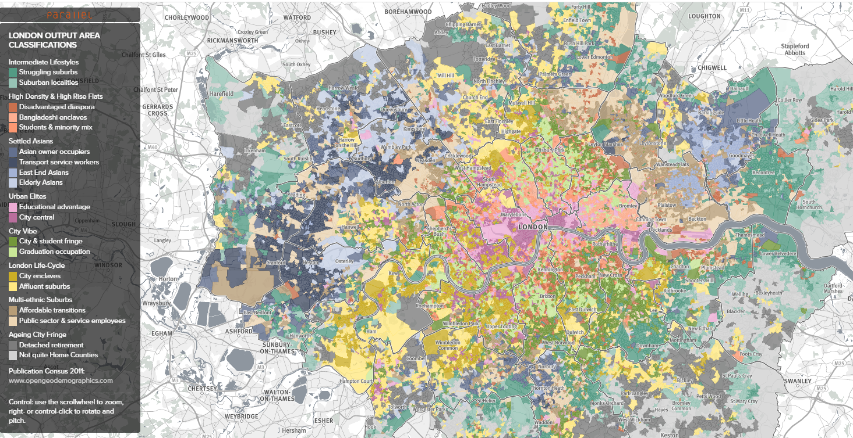
LOAC
https://parallel.co.uk/loac/
Clustering OAs on 70+ socio-economic variables (non-spatial); 32000 OAs are clustered into 8 groups
Clusters have obvious spatial patterns (!!)
https://parallel.co.uk/loac

Slide 33
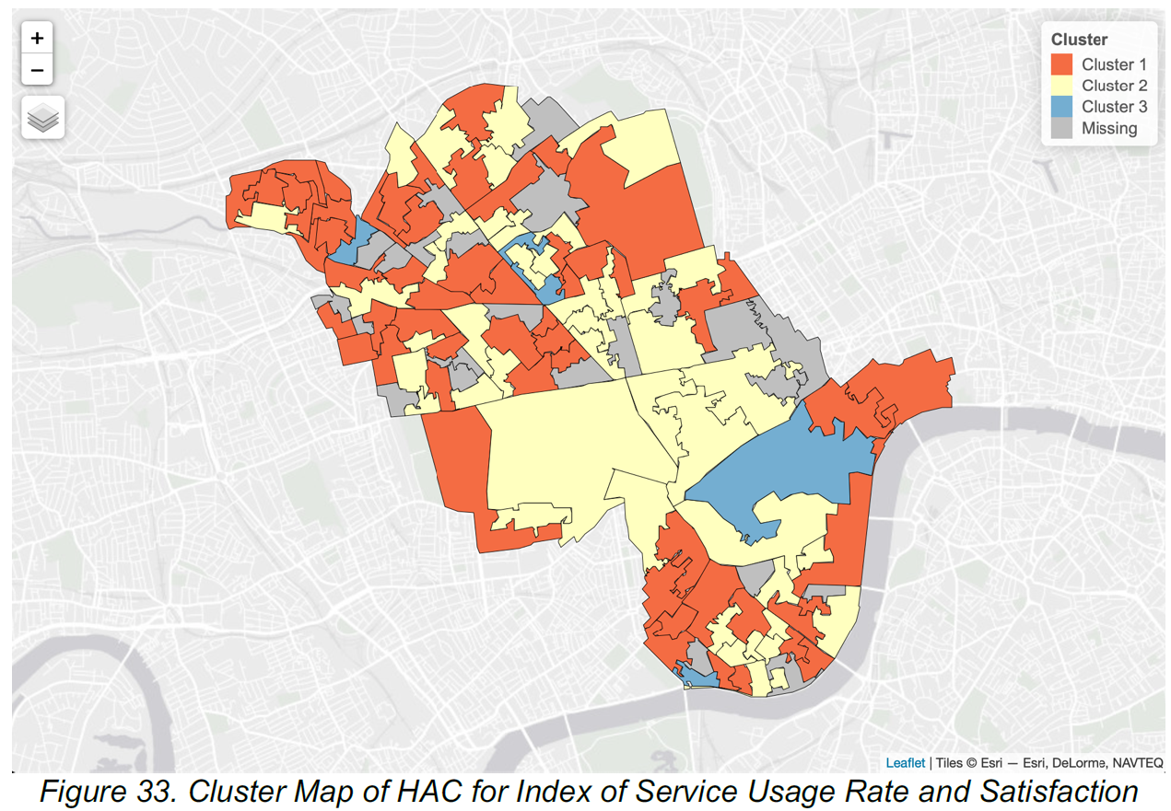
Understanding Residents’ Attitude towards Services and Safety Issues By Geodemographics based on City Survey Results (MRes, 2019)
Input data:
20 survey questions
Result interpretation
Cluster 1: Environment Unsatisfied
Cluster 2: Outdoor Facilities Unsatisfied
Cluster 3: Newcomers
Notes:
This is the map of London output area classification, using the clustering technique. It looks at the 2011 census area data for just London, putting each of 32000 small output areas into one of 8 groups.

Slide 34
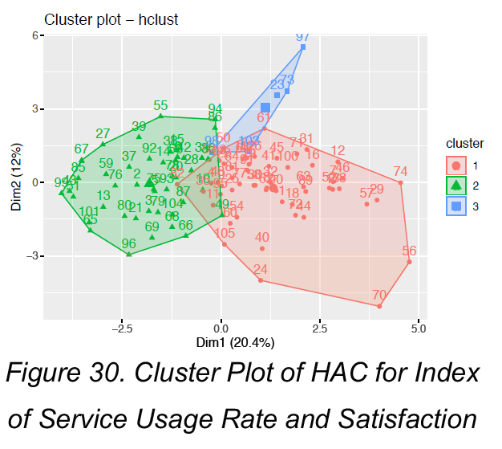
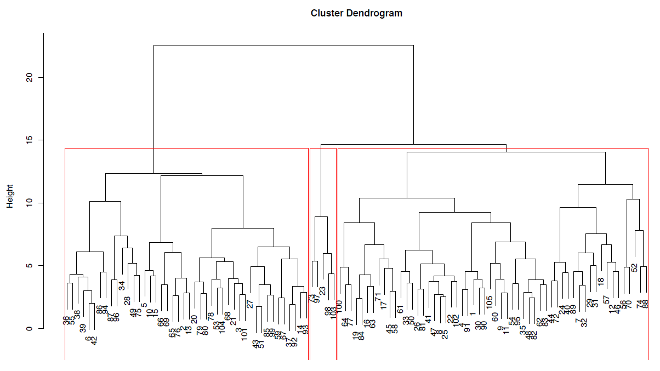
Understanding Residents’ Attitude towards Services and Safety Issues By Geodemographics based on City Survey Results (MRes, 2019)
Cluster Dendrogram
Notes:
This is the map of London output area classification, using the clustering technique. It looks at the 2011 census area data for just London, putting each of 32000 small output areas into one of 8 groups.

Slide 35
Approach Two
Clustering on non-spatial variables while adding constraints of ‘geographic cohesion’
Regions are ‘coherent’ if and only if they are geographically contiguous or connected
Also called Regionalization or districting or spatially constrained clustering in literature.
Pros: it simultaneously considers feature homogeneity and geographic cohesion
Cons: it can be difficult to ensure that clusters both represent a place as well as a type of observation

Slide 36
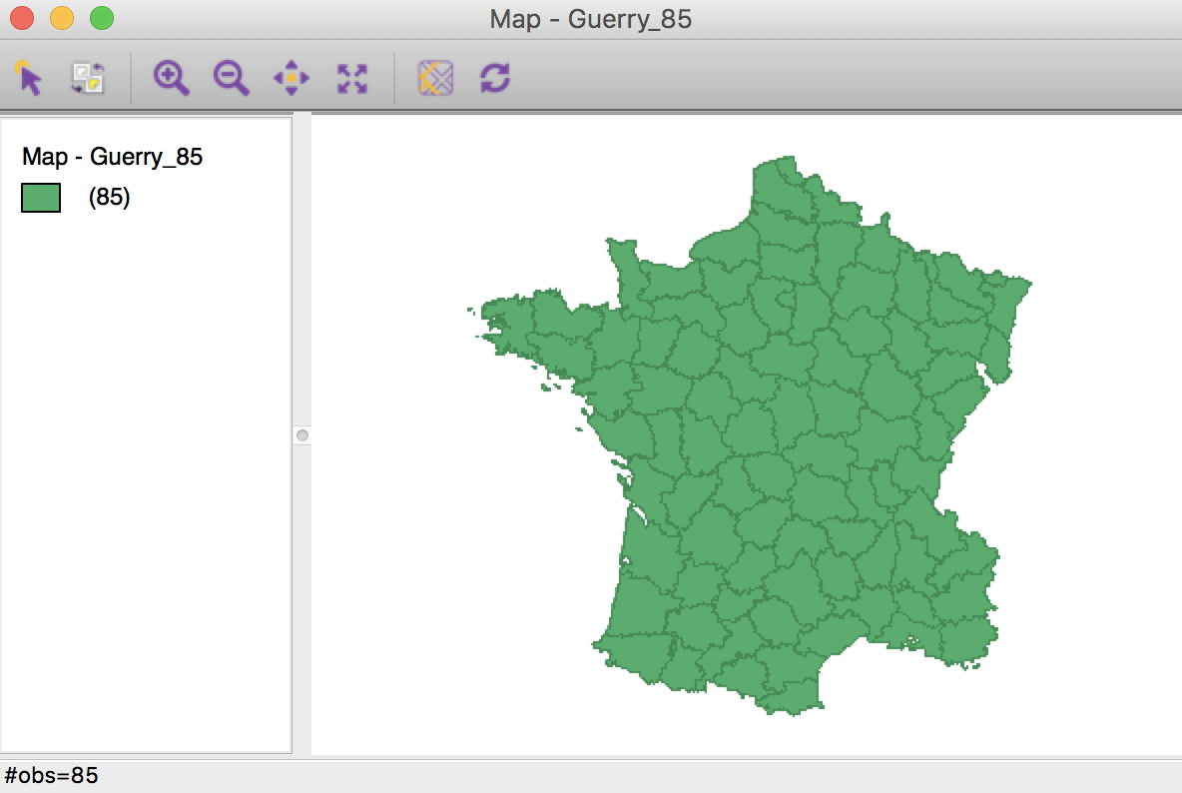
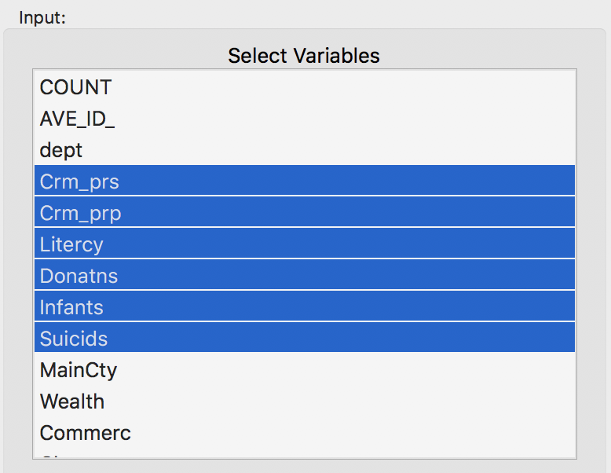
The max-p method
Max-p: clustering of a set of geographic areas into the maximum number of homogeneous regions such that:
Each region is spatially contiguous
The value of each region (e.g. population) is above a predefined threshold value
We will compare kmeans and max-p in a case study: Guerry data set on moral statistics in 1830 France
https://geodacenter.github.io/workbook/8_spatial_clusters/lab8.html

Slide 37
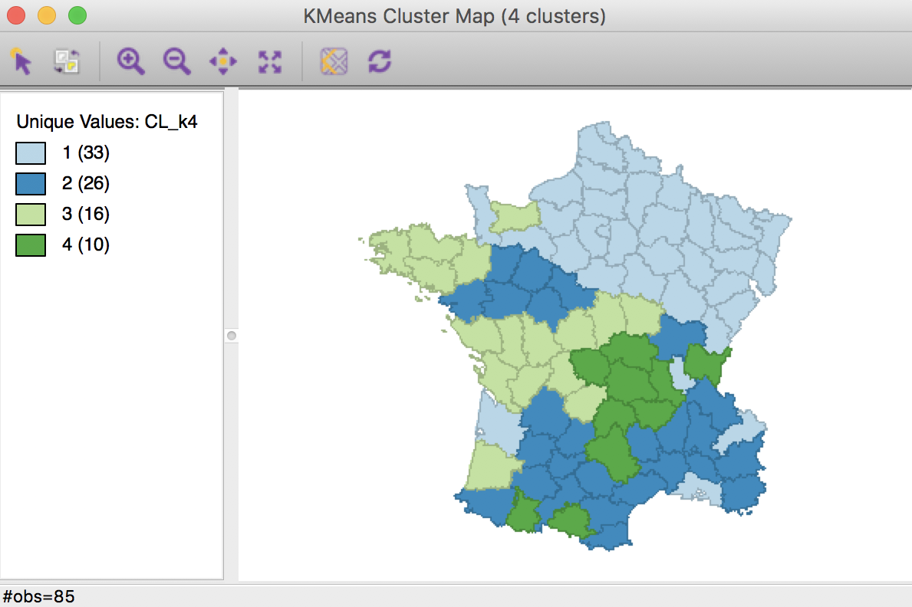
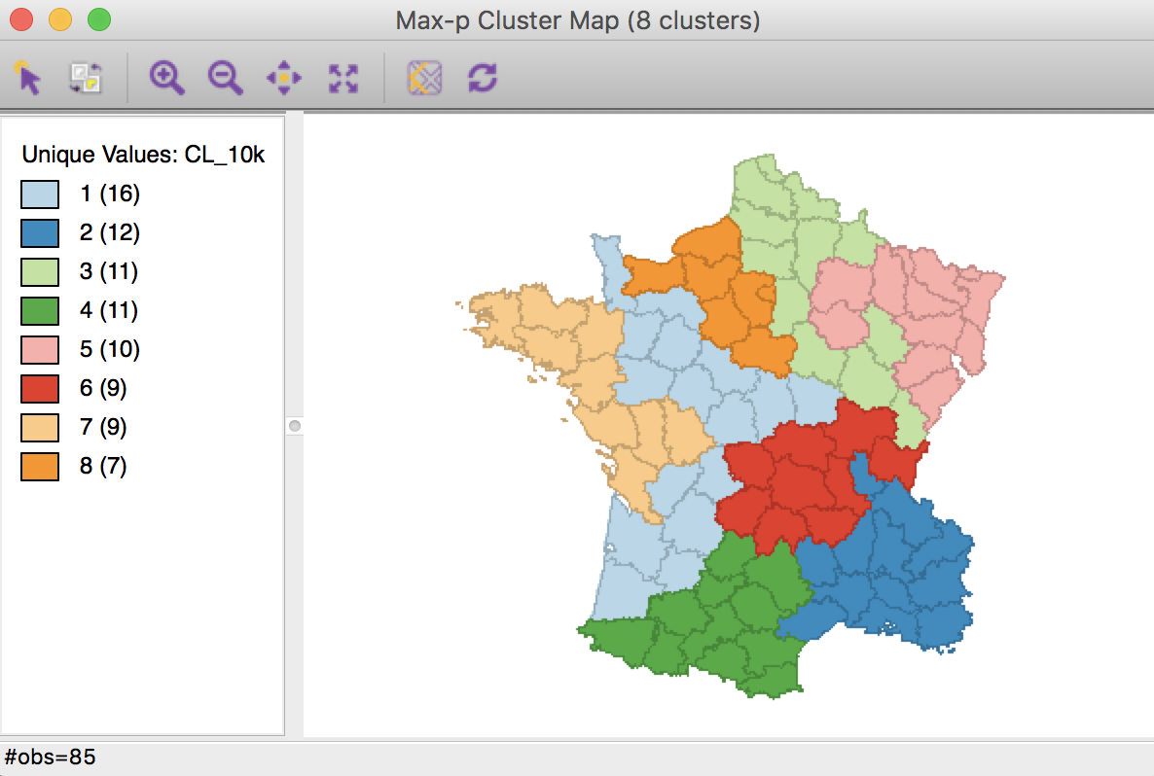
K-means result
None of clusters is spatially contiguous
Max-p result
Requiring each cluster has at least 10% total population; each region is spatially contiguous
https://geodacenter.github.io/workbook/8_spatial_clusters/lab8.html
https://pysal.org/spopt/notebooks/maxp.html

Slide 38
Measuring Clustering Quality How do you know the clusters make sense?
Necessary when...
Comparing different implementations of a clustering method with randomness (e.g., k-means)
Comparing clustering with different parameters (e.g., numbers of clusters)
Comparing different clustering methods
Notes:
Finally, for clustering, I would like to introduce some measures. Lets say, you have done clustering on a dataset and got some result, and you want to explain why the result is reasonable.
This is a headache for most users of clustering, as it is unsupervised in nature, and so it is difficult to validate the result. Mostly, people use visualisation analysis or silhouette score. This score is a ratio of mean distance between all points in assigned cluster and all points in other clusters.
If you have some ground truth data, you can test for homogeneity and completeness. Homogeneity requires that all clusters contain only points from a single observed class, while completeness requires all members of given class are within the same cluster.
SSE
Silouette score
Homogeneity, completeness

Slide 39

Method 1: SEE / Elbow Method
SSE: Sum of Squared Errors
$$SSE=\sum_{i=1}^{n}{\sum_{j=1}^{k}{w^{\left(i,j\right)}dist(x^{\left(i\right)},μ^{(j)}) }}$$
Where: i is a data point, j is a cluster, and w(i,j)=1 when i is in cluster j, otherwise 0.
The range of SSE? [0, infinity)
When the points in each cluster are identical, SSE = 0
When #observation = #cluster, SSE = 0

Slide 40
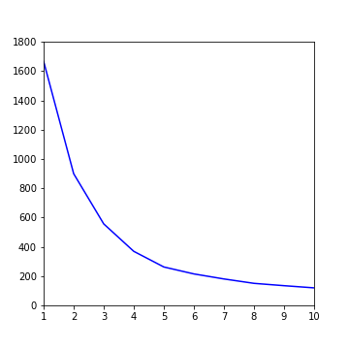
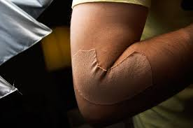
Method 1: SEE / Elbow Method
Elbow diagram: help choose k for k-means
Y
SSE
X
k (Number of Clusters)

Slide 41
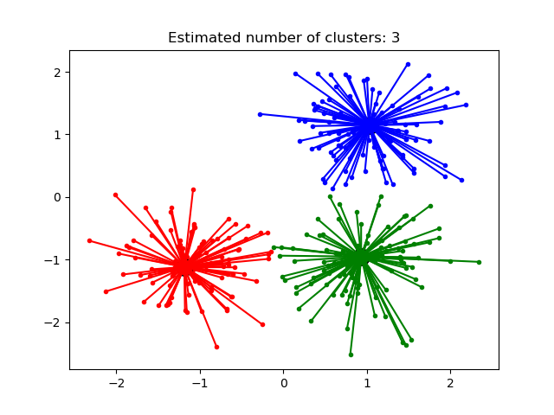


Method 2: Silhouette Analysis
Silhouette of a point
“Is this point closer to points of the same cluster, or any other cluster? ”
$$s(i)=\frac{b\left(i\right)−a(i) }{max⁡\{a\left(i\right),b(i)\}}$$
$a\left(i\right)$: mean distance to points of the same cluster
$b\left(i\right)$: minimum mean distance to points of another cluster
$−1≤s\left(i\right)≤1$；the larger s(i), the higher clustering quality
Silhouette Score
for a Clustering
=
Average of s(i)
for all points i

Slide 42
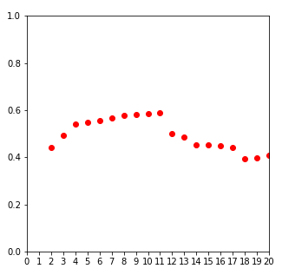
Method 2: Silhouette Analysis
Choose k for k-means
Y
Silhouette Score
X
k (Number of Clusters)

Slide 43
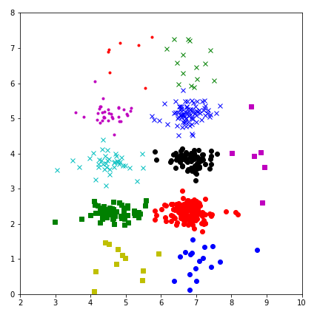
Method 2: Silhouette Analysis
Y
‘Optimal’ k-Means
k = 11
S. Score = 0.59
X

Slide 44
Method 3: Comparing against ‘ground truth’
Homogeneity
All clusters contain only points from a single observed class – expressed as a proportion of clusters for which this is true
Completeness
All members of given class are within the same cluster – expressed as a proportion of classes for which this is true
Scenario 1
 | C1 | C2 | Overall
Homogeneity | 1 | 1 | 1
 | OC1 |  | Overall
Completeness | 0 |  | 0
Clustering
C1
C2
Observed class (ground truth)
OC1
https://scikit-learn.org/stable/modules/clustering.html#homogeneity-completeness

Slide 45
Method 3: Comparing against ‘ground truth’
Homogeneity
All clusters contain only points from a single observed class – expressed as a proportion of clusters for which this is true
Completeness
All members of given class are within the same cluster – expressed as a proportion of classes for which this is true
Scenario 2
 | C1 | C2 | Overall
Homogeneity | 1 | 1 | 1
 | OC1 | OC2 | Overall
Completeness | 1 | 1 | 1
Clustering
C1
C2
Observed class (ground truth)
OC1
OC2
https://scikit-learn.org/stable/modules/clustering.html#homogeneity-completeness

Slide 46
Method 3: Comparing against ‘ground truth’
Homogeneity
All clusters contain only points from a single observed class – expressed as a proportion of clusters for which this is true
Completeness
All members of given class are within the same cluster – expressed as a proportion of classes for which this is true
Scenario 3
 | C1 | C2 | Overall
Homogeneity | 1 | 0 | 0.5
 | OC1 | OC2 | Overall
Completeness | 0 | 1 | 0.5
Clustering
C1
C2
Observed class (ground truth)
OC1
OC2
https://scikit-learn.org/stable/modules/clustering.html#homogeneity-completeness

Slide 47
Method 3: Comparing against ‘ground truth’
Where is the ‘ground truth’ from?
You have some ground truth available;
The ‘ground truth’ can come from a different but relevant task. Be sure to prove these tasks are relevant.
You can ask some domain experts for their opinions. This is very common and useful.
https://scikit-learn.org/stable/modules/clustering.html#homogeneity-completeness

Slide 48
Next steps of clustering Very important !
Visualisation (often combined with dimension reduction, e.g. PCA)
Qualitatively describe cluster characteristics
Mapping the clusters (do these clusters cluster in space?)
Compare against expert knowledge

Slide 49
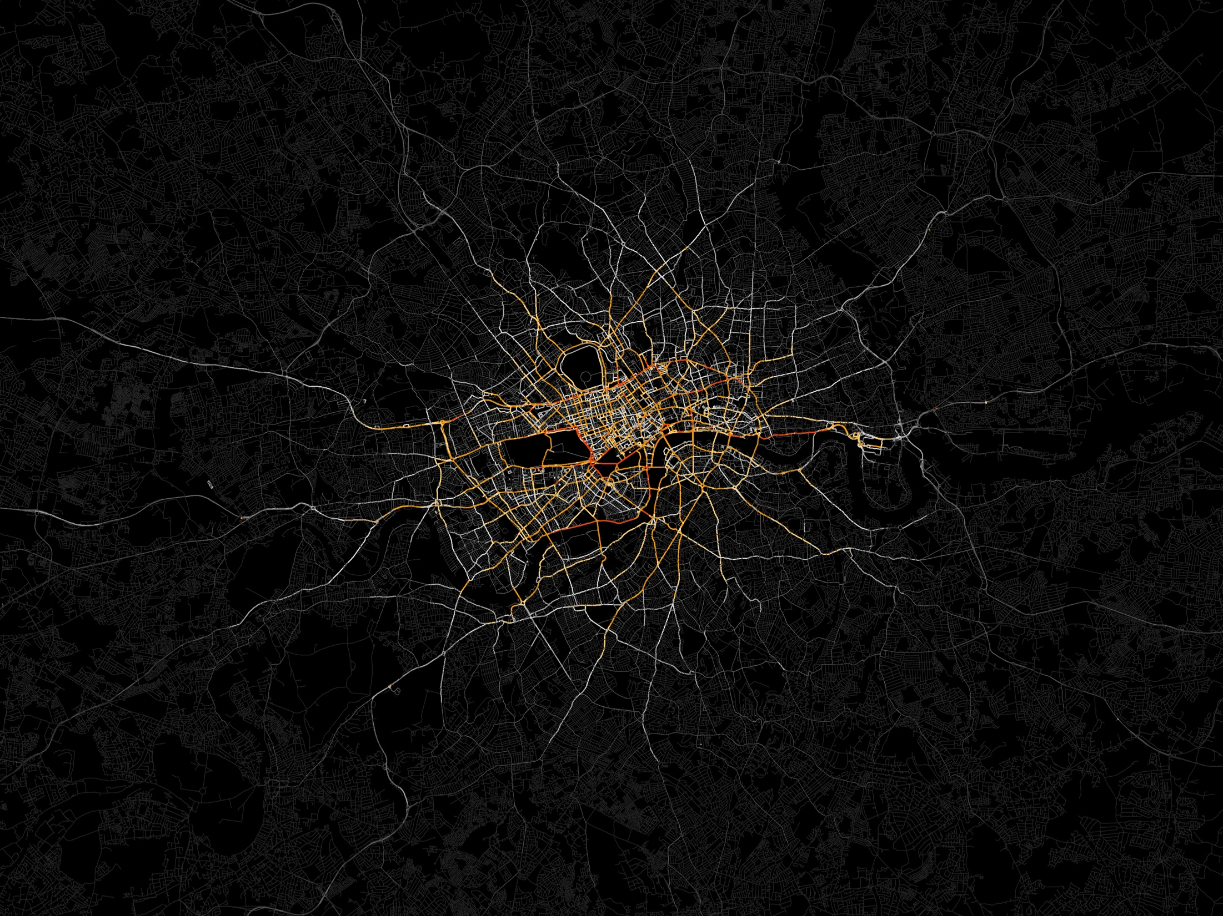
Thank You
Questions?
Huanfa Chen
huanfa.chen@ucl.ac.uk

Slide 50
Workshop Data Mining
This workshop will focus on using clustering methods to analyse a multivariate dataset
You’ll learn how to use the scikit-learn and pysal Python library for clustering analysis
Don’t worry about the maths for clustering. You’re not expected to understand all the maths and algorithms. The key skill is the application, validation, and interpretation of the methods and results.

